Slide 1
Restaurant Ratings Analysis
Group 4:
Shanu Mariam Joseph
Hirdeyjot Singh Bansi
Sebastian Campos
Amy Tieku

Slide 2
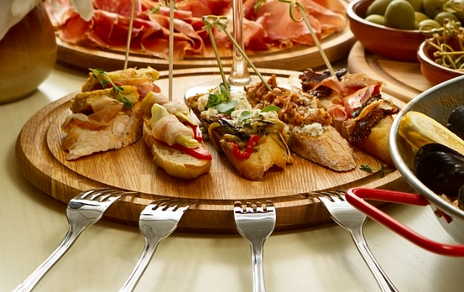
Selected Topic and Reason
Our selected topic is restaurants and their star ratings. We want to be able to predict the star rating of the restaurant based on various attributes such as:
Price
Noise Level
Whether it Serves Alcohol or Not
Restaurant Attire
Etc
Our reason for this topic is that some restaurants, new ones in particular, not have many Yelp ratings. This analysis should help.
Notes:
While Yelp is a standard place to go for reviews, restaurants that are new may not have many ratings. This analysis will assist patrons in finding new restaurants.
We hoped to answer:
Are the star ratings correct based on number of reviews and other attributes?
Can we predict the average review per city per category?
What is the percentage for positive and negative reviews per city per category?
What are the top 5 restaurants in a city?

Slide 3
Source of Data
The Dataset came from Yelp. It contains 5 different json data files out of which we are using business.json and review.json files for our analysis. The rest of the data is out of scope for our analysis.
The business.json file contains business data including location data, attributes, categories and star ratings for the restaurants.
The review.json file contains review data including the user_id who wrote the reviews, the business_id for which the review is written and the star reviews for each of the restaurant.
Notes:
Technologies used: Pandas, SQL, Jupyter Notebook (Pythondata or Python3), PG Admin, Google Cloud
Algorithms: Linear Regression, SMOTEEN, SMOTE
Tell about how data was cleaned, and how records went down from 18,000 to 5,000.
In the data exploration phase of the project, we researched:
What tables we should use? The reviews table was huge and we only extracted xx columns out of it.
What attributes should we use? What attributes were important and made sense?
What attributes needed to be broken out (non-boolean values) so we could work with them?

Slide 4
Technologies Used
Pandas
SQL
Jupyter Notebook
PG Admin
Google Cloud
Algorithms
  Polynomial Linear Regression
  Neural Network Classifier

Slide 5
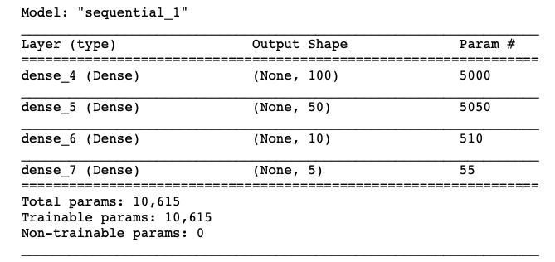
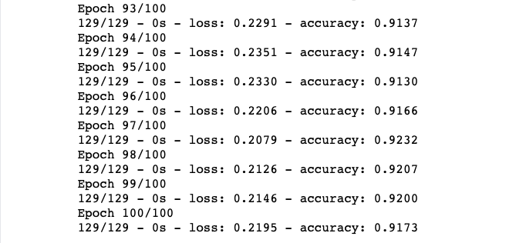
Machine Learning Model
Model Summary
Fitting Model
1 of 3
Notes:
A new table was created in postgres using an inner join between our two tables business_table and attributes_table on the business_id column.
The data was imported into a jupyter notebook as a dataframe, the data frame was then split into two variables: our X or features variable and or y or target variable. utilizing the python modules tensorflow and sklearn we split the data into training and testing sets.
The data was then scaled using the StandardScaler imported from the sklearn library
A Sequential model was instanted from the tensorflow library and built with four layers. the first 3 using the relu activation and the last one with the soft max activation.
This model was chosen for its ability to classify a target column and improve predictions as more data is presented.

Slide 6
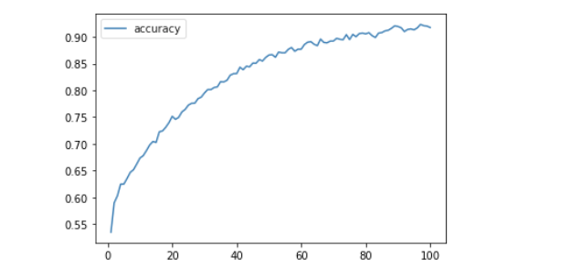
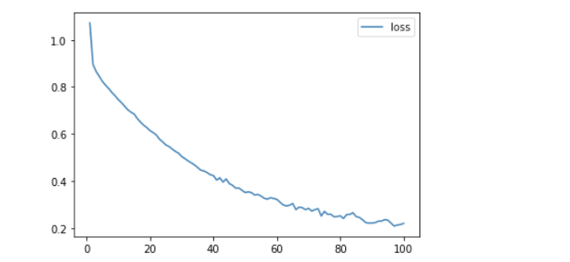
Machine Learning Model
Accuracy Plot
Loss Plot
2 of 3

Slide 7
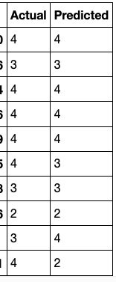
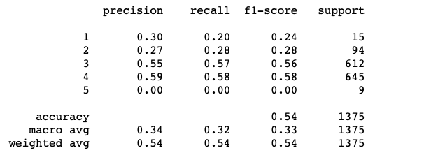
Machine Learning Model
Predictions
Classification Report
3 of 3
Notes:
Our classification report shows an unfortunately low accuracy to predict the correct star rating for Restaurants

Slide 8
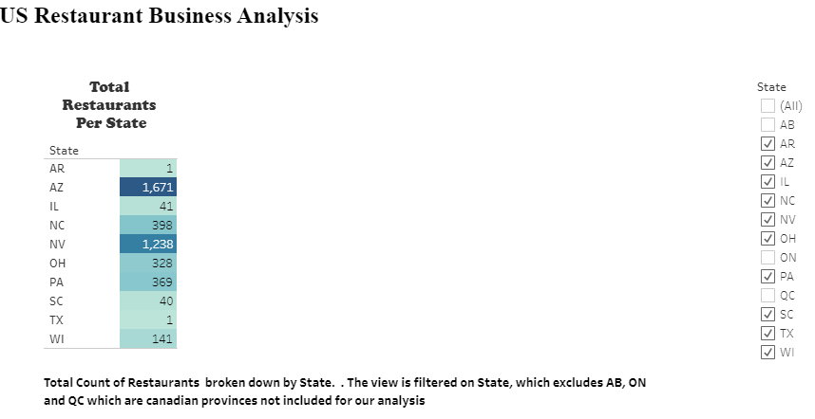
Exploratory Data Analysis
1 of 3
Notes:
Using Tableau

Slide 9
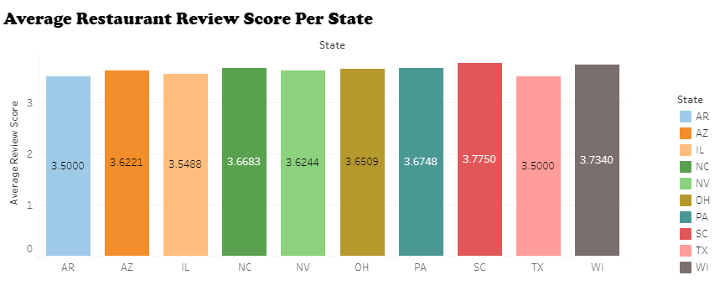
Exploratory Data Analysis
2 of 3
Notes:
Using Tableau

Slide 10
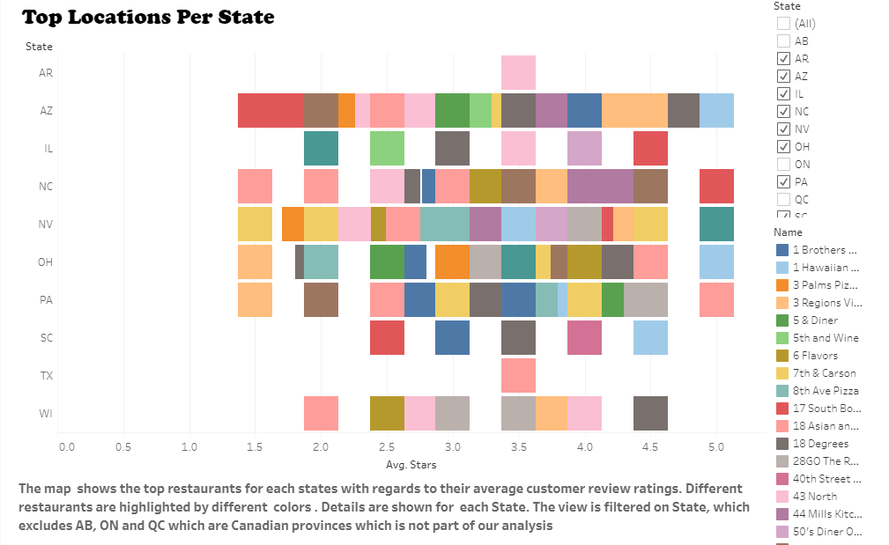
Exploratory Data Analysis
3 of 3
Notes:
Using Tableau

Slide 11
Results and Recommendations
Results:
Given the data, we could not very well predict whether a new restaurant of a certain category or with certain attributes would be successful.
Recommendation for a future analysis:
Get a better dataset. Yelp is very hit-or-miss.
Possibly get survey data from restaurant critics since they are professionals and evaluate restaurants in-depth.
Focus on one geographical area (city) that we know has many competitive restaurants.
Have different categories represented.
Notes:
The cleaned dataset only had 10 states and 3 Canadian provinces.

